Slide 1
Extreme Dragons: Mateo Aviles, Brannon Bowlin, Muhammad Faruqui, Sam Cimino, Clifton Sims
Project 4
Cryptography
And
Steganography

Slide 2
Problem Statement
Implement an image stegosystem that takes an 8 bit greyscale bmp image, hides a message into the least significant bit (LSB) of each pixel, extracts the message from the stego image, and attack a suspicious image if it is one.
Implement another stegosystem besides LSB. I decided to use midi audio files. The goal was to hide a user given message into a meta event and extract the message by looking going to the meta event in track we created. Given an .mid file we needed to know whether or not it had any secret messages embedded. If it did we need to display this message to the user.
RSA

Slide 3
RSA Implementation

Slide 4
LSB Image Stegosystem Implementation
Use EasyBMP library to read file, check if the image is a valid 8 bit greyscale bmp image, and get the offset of where the pixels of the image starts so that we can manipulate them to hide our secret message.
Secret message was broken into characters which are known to be 8 bits. To hide these 8 bits we pulled out a character from the file we are reading from and changed the LSB bit to the first bit of the character we are trying to hide. We then write these 8 bits into the file specified by the user (The header and meta data is written into this file before this process).
After the above eight times we get a new character and continue this process until all the characters form the message have been embedded.
We then add a terminator character that signifies the end of the message. We use the terminator when extracting the message to know when to stop reading the file for the message.
Extraction was solved by simply finding out where the image pixels started in the file and reading form there until we reached the terminator character. In our implementation we made the terminating character this: '|'. We could have let the user specify the terminating character but we didn't.

Slide 5
MIDI Stegosystem Implementation
To read and write midi audio files we used a library called Midifile. Using the Midifile library we were able to get the track count and event count for iterating, add tracks and meta events and set midi messages for hiding user given messages, and check the midi file's status.
We added an identifier on the front of the given secret message so that we know which meta event to look at for the extracting the message. This string is then passed as a c-string for writing as a midi message.
Using the library’s MidiFile object we were able to write all the contents read from a given file into the file specified by the user as the output file.
Extraction was solved by simply going to the last track and reading the meta event and message contained in it. In our implementation we made the identifier character this: '|'. We could have let the user specify the terminating character but we didn't.

Slide 6
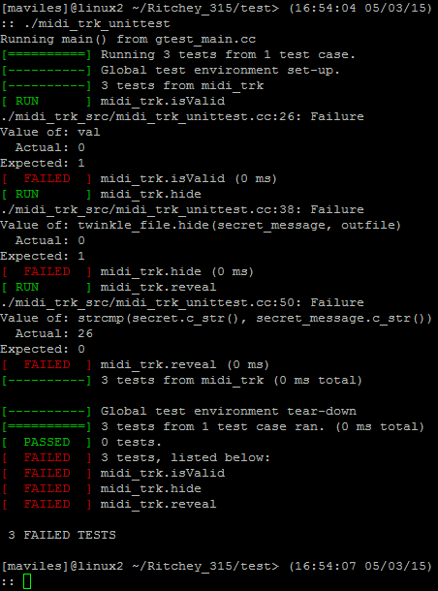
TDD - Fails
RSA
MIDI stego

Slide 7
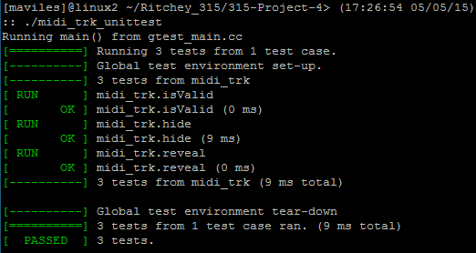
TDD - Success
RSA
MIDI stego

Slide 8
Restrictions and Limitations
The downside of embedding a message in a .mid file using the technique I used is that it increases the file size. This can be avoided using existing meta events already in the file but some may not have any or if they do they are not very long.
In LSB I hid each character one after the other. It would be better to hid characters throughout the file to avoid easy detection.
RSA

Slide 9
Conclusions
In completing this project I learned a lot about…
the file structure of .mid and .bmp files.
How to structure code through the libraries used in this project (I thought they were both very good).
Writing better makefiles
TDD
Scrum
In this project I showed how to hide messages in .bmp and .mid files using simple techniques.
RSA

Slide 10
Future research and improvements
RSA
Improvements
Better hiding for both stegosystems. Use different or more than one technique. Play the midi on an instrument. See the midi file through software.
Learn more about midi.
Get better at writing makefiles.

Slide 11
References
RSA
LSB Image Stegosystem
Paul Macklin's C++ Bitmap Library
http://easybmp.sourceforge.net/
MIDI Stegosystem
Craig Stuart's C++ library for parsing Standard MIDI Files
http://midifile.sapp.org/
Research & Info
Compares ways of hiding info in midi
http://ieeexplore.ieee.org/stamp/stamp.jsp?arnumber=1527346&tag=1
Midi file structure
http://cs.fit.edu/~ryan/cse4051/projects/midi/midi.html

